Slide 1


Defence Institute of Advanced Technology
MID-SEM EVALUATION PRESENTATION
SDLC Using Agentic AI
Building an Adaptive AI Software Engineering Organization
SUBMITTED BY
GUIDES
Abhishek Raj (25-26-15)
Prof. CRS Kumar
M.B. Sai Charan (Scientist C, RCI DRDO)

Slide 2
Problem Statement and Hidden Challenges.
3. The Local Hardware Wall:
While the goal is local execution, taking current multi-agent architectures away from massive cloud servers and deploying them on constrained local hardware (like a single GPU) breaks them completely.
The Result:
Because local models lack massive context windows, feeding them entire repositories causes memory exhaustion, high latency, and severe logic hallucinations.
1. The Cloud Barrier:
Defense and enterprise organizations cannot expose proprietary, sensitive source code to external third-party cloud LLMs due to strict data privacy mandates.
2. The Project Goal:
Build an autonomous Software Development Lifecycle (SDLC) framework that operates entirely offline, keeping all code and execution securely within local infrastructure.

Slide 3
Literature Review & Core Gaps
To solve the local deployment bottlenecks, we first analyzed the theoretical foundations and limitations of current AI workflows to understand exactly what our architecture needed to fix.
LLM-Based Multi-Agent Systems for Software Engineering: Literature Review, Vision, and the Road Ahead (He, J., Treude, C., & Lo, D., 2025): (Multi-Agent Task Delegation): Establishes the necessity of dividing SDLC workflows among specialized agents. It identifies long-term memory and context limits as the primary blockers for enterprise adoption, validating our need for a token-efficient project graph.
Assistance to Autonomy: A Systematic Literature Review of Agentic AI across the SDLC (Apostolou, S. A., et al., 2026): (The Verifiability Principle) : Highlights that software automation only works if the outputs can be systematically verified. The paper notes that current agents lack robust evaluation harnesses, driving our integration of a self-correcting Reflexion loop.
Agentic AI in the Software Development Lifecycle: Architecture, Empirical Evidence, and Operational Mechanics (2026): (Empirical Failure Benchmarks): Real-world benchmarking reveals that agents quickly lose architectural consistency during extended sessions. This proved that standard generative prompting is insufficient, pointing us directly toward isolated, surgical code editing.
The Hitchhiker's Guide to Agentic AI: From Foundations to Systems(Roitman, H., 2025) : (Agentic Harness Engineering) : Provides the theoretical blueprint for separating an LLM’s raw reasoning from its physical execution environment. We translated these concepts—like state management and loop engineering—into our offline LangGraph pipeline.
Codebase-Memory: Tree-Sitter-Based Knowledge Graphs for LLM Code Exploration via MCP (2026): Tree-Sitter Knowledge Graphs: Demonstrates how to map entire repositories without exceeding token limits by parsing Abstract Syntax Trees (AST) and scoring dependencies. This methodology directly inspired the structural foundation of our Hierarchical Software Knowledge Graph (HSKG).

Slide 4



THE CHALLENGE
Local Hardware Constraints
The Context Window Bottleneck
Local models cannot process massive amounts of code at once. Flooding their limited context window with full repository text leads to high latency, severe memory degradation, and logic hallucinations.
Absence of Topological Memory
Standard RAG relies on flat keyword searches, lacking any real structural understanding of the project. It frequently misses distant structural dependencies, like how a backend database update might break a frontend controller.
Generative Rewriting
Current frameworks tend to rewrite entire files from scratch just to implement minor feature requests. This approach is highly inefficient for local models and risks the accidental deletion of untouched, perfectly working code.

Slide 5
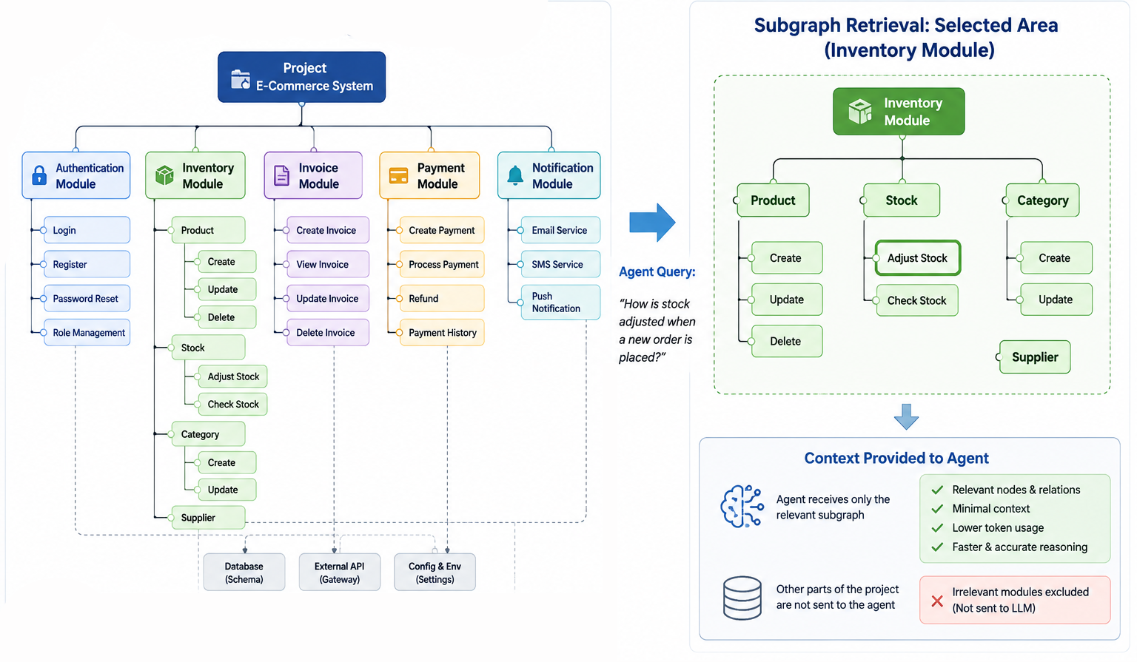
APPROACHS
Hierarchical Software Knowledge Graph
Context-aware project memory.
AST Parsing: Models codebase as a directed, attributed multigraph.
Nodes & Edges: Tracks modules, functions, and semantic relationships (calls, modifies).
Topology: Retrieves strict k-hop subgraphs instead of flat text files.
Drastic token footprint reduction.

Slide 6
APPROACHS
Surgical Patching via Stack-Based Editor Loop
Eliminating full-file generative rewrites by breaking complex requests into atomic, memory-efficient steps.
01. Analyzer
02. Editor
03. Reviewer
Breaks the user's large request into a "stack" of bite-sized, step-by-step tasks. By forcing the AI to deal with only one small task at a time, we completely avoid overwhelming the local model's limited memory.
Picks up the top task from the stack, loads just the exact code it needs from the graph, and performs a precise "search-and-replace" edit. It never rewrites an entire file from scratch, protecting the untouched, working code.
Checks the newly patched code against the project requirements to ensure it actually works. If it spots a mistake, it sends an error report right back to the Editor so the AI can learn from it and fix it immediately.

Slide 7
PROGRESS
Implementation & Preliminary Results
Results & Focus
Implementation Tracks
Core Planner Node Built: The foundational logic that acts as our "Analyzer Node” is complete. The system can now analyse the entire repo and form the knowledge graph of it as well as receive a user request and attempt to break it down into a step-by-step task stack.
Active Optimization: Our immediate priority is fine-tuning this Analyzer node to hit a strict accuracy threshold before finalizing the Editor and Reviewer nodes.
Current Engineering Goals:
Accurate Repository Mapping: Ensuring the AI perfectly reads and understands the existing codebase without missing context.
Flawless Task Stacks: Training the Analyzer to generate a completely logical, ordered stack of edits that doesn't break hidden dependencies.
1. Demonstration Prototype
We built a functional, simplified workflow to prove the concept. It successfully takes a user request and autonomously generates complete mini web applications (HTML/JS/CSS).
2. Enterprise Scale (In Progress)
For real-world codebases, we are actively developing the core Analyzer node. This parses the repository to create the Knowledge Graph and builds a visual UI so humans can understand the AI's map.

Slide 8
Conclusion & Future Scope
The integration of the Hierarchical Software Knowledge Graph (HSKG) and stack-based execution successfully addresses the memory and context limitations of local, offline LLMs. Moving toward the end-semester evaluation, our primary focus is stabilizing the workflow to ensure the generated code patches are highly accurate and functionally coherent. Additionally, we will fully automate the codebase mapping using Tree-sitter for native AST parsing, finalize a visual dashboard for human oversight, and integrate Agent-to-Agent (A2A) protocols to seamlessly delegate testing and deployment tasks to isolated containerized agents.

Slide 9
Key References
1.
He, J., Treude, C., & Lo, D. "LLM-based multi-agent systems for software engineering: Literature review, vision, and the road ahead," ACM Trans. Softw. Eng. Methodol., 2025.
2.
Apostolou, S. A. et al., "Assistance to autonomy: A systematic literature review of agentic AI across the SDLC," arXiv preprint, 2026.
3.
Anonymous et al., "Agentic AI in the software development lifecycle: Architecture, empirical evidence, and operational mechanics," arXiv preprint, 2026.
4.
Anonymous et al., "Codebase-Memory: Tree-Sitter-Based Knowledge Graphs for LLM Code Exploration via MCP," arXiv preprint, 2026.
5.
Roitman, H., The Hitchhiker's Guide to Agentic AI: From Foundations to Systems, 1st ed. New York, NY: TechPress, 2025.

Slide 10

Thank You
Questions & Discussion

